Slide 1
House Pricing Prediction
Supervisor:
Eng/Abduallah Wagih
Members:
1-Ahmed Gamal – 4230222
2-Abdelrheem Elsayed --4230754
3-Ahmed Mahmoud --4230800
4-Ibrahim Ashraf -- 4230920

Slide 2
Objectives:
Predict the price of a house based on its
taskGoal: Build accurate ML models and compare them
This project aims to preform supervised(Features,Labels) regression analysis on housing dataset to estimate property prices it involves data preprocessing feature engineering

Slide 3
Dataset Overview(2000,9)
Features:
Area (sq ft)
Bedrooms
Bathrooms
Floors
YearBuilt
Garage
Condition
Location
Target: Price

Slide 4
Data collection
I can use too:
Database(SQL) API(Application Program Interface) Web Scrapping

Slide 5
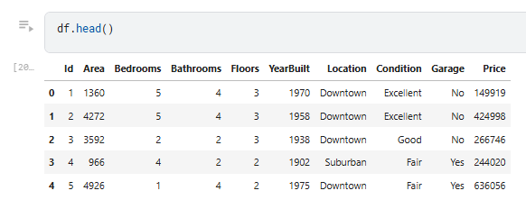
Data Representation

Slide 6
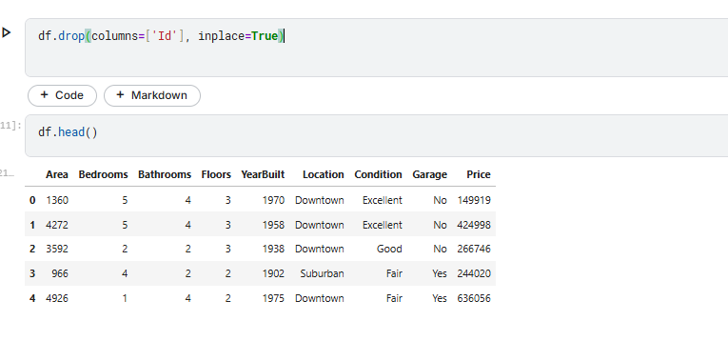
Data Wrangling
Drop unneeded column
Drop duplicated
Handle missing value

Slide 7
Analysis
Univarient Analysis
Bivarient Analysis

Slide 8
Exploratory Data Analysis
Bivarient:
Correlation countplot
Boxplots
Scatterplots to detect outliers
Univarient:
Pie
Bar
Histogram

Slide 9
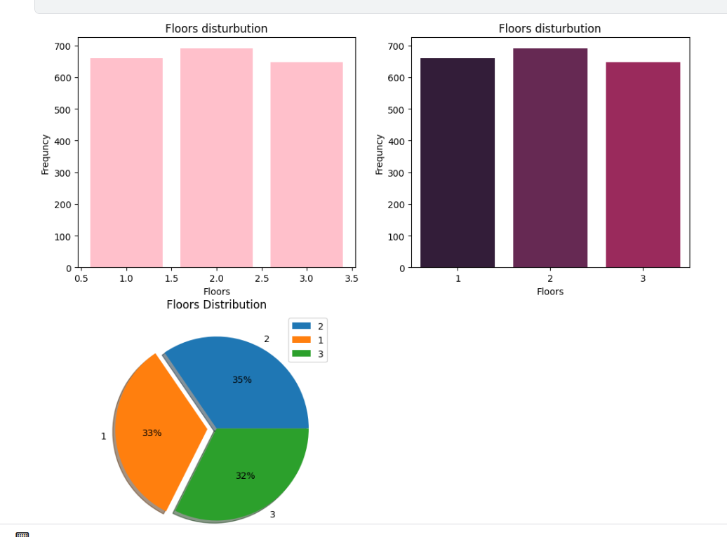
Floor Analysis

Slide 10
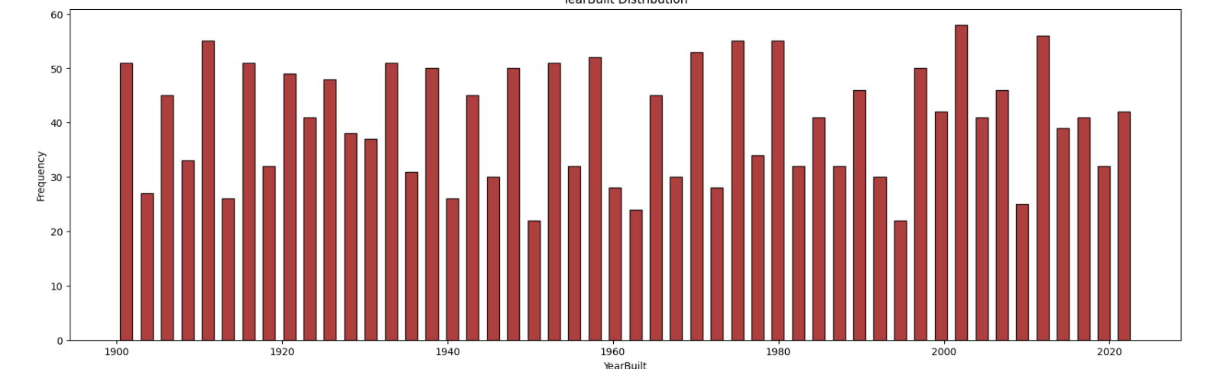
YearBuilt Analysis

Slide 11
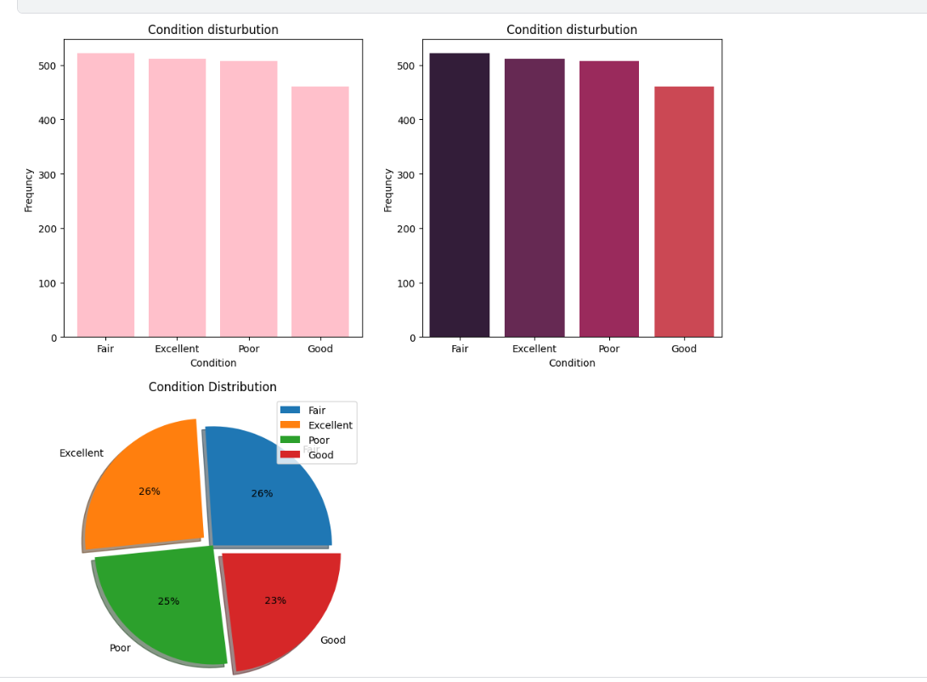
Condition Analysis

Slide 12
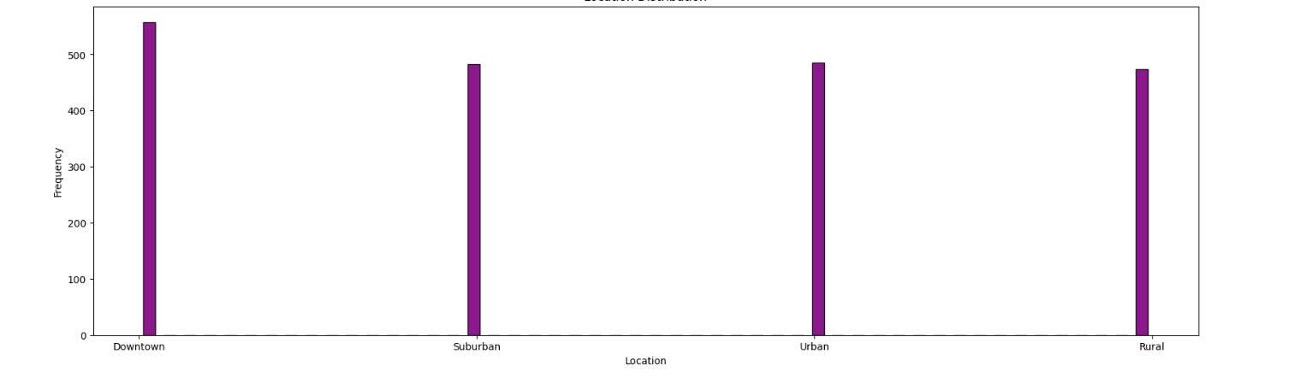
Location Analysis

Slide 13
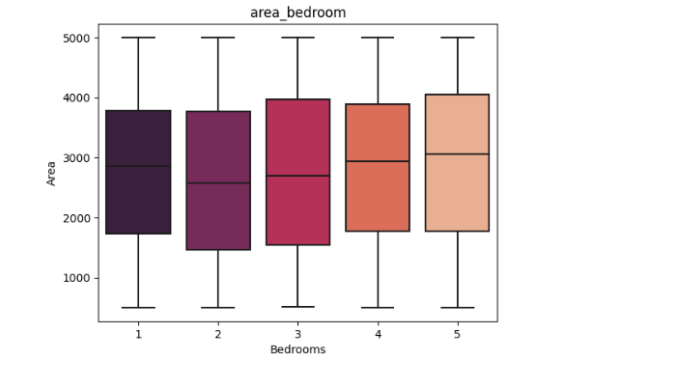
Area and Bedrooms Analysis

Slide 14
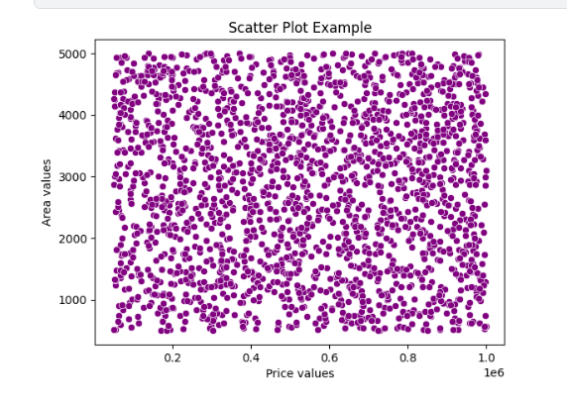
Area and Price Analysis

Slide 15
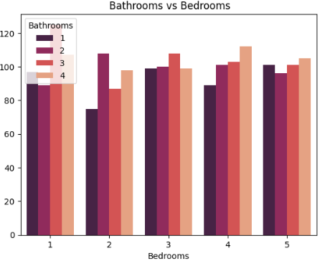
Bathrooms And Bedrooms Analysis

Slide 16
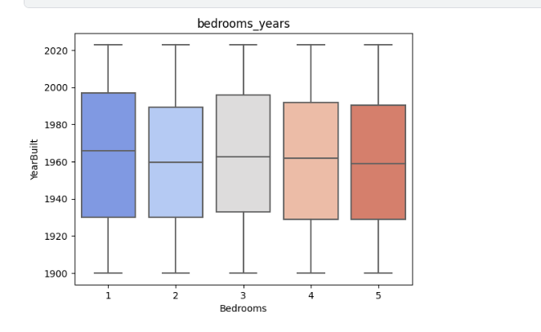
Bedrooms And Area Analysis

Slide 17
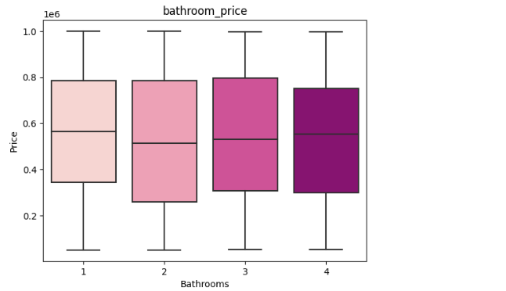
Bathroom And Price

Slide 18
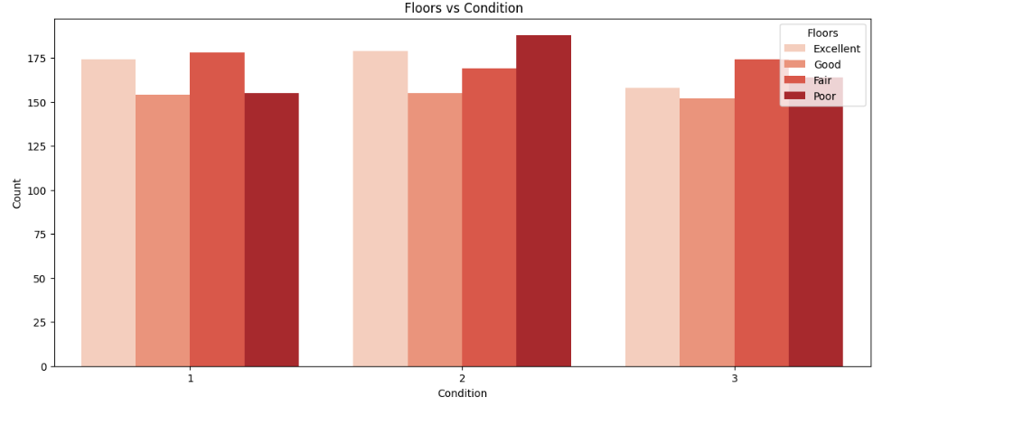
Floors And condition

Slide 19
Data Preprocessing
Handled missing values
Encoded categorical features (LabelEncoder)
Scaled numeric values (StandardScaler or MinMaxScaler)
Split data (Train 80%, Test 20%)

Slide 20
Regression Models Used
Linear Models:
LinearRegression:
A basic model that finds the straight-line relationship between the features and the target (house price).
Ridge Regression:
Similar to LinearRegression but adds a penalty to reduce overfitting by shrinking the model coefficients.
Lasso Regression:
Like Ridge, but it can also eliminate irrelevant features by setting some coefficients to zero (feature selection).
SGDRegressor:
A fast linear model that uses stochastic gradient descent. Great for large datasets or online learning.

Slide 21
SVM Models
SVR (Support Vector Regressor):
Tries to find the best-fit line within a margin of error. Can handle non-linear relationships using kernels.
LinearSVR:
A faster version of SVR that only uses a linear kernel. Works well for simple linear relationships.

Slide 22
Distance-Based Model
KNeighborsRegressor:
Predicts house prices by averaging the prices of the nearest neighbors (houses with similar features).
Tree-Based Model
DecisionTreeRegressor:
Splits the data based on feature values into branches to make predictions. Easy to interpret but may overfit.

Slide 23
Ensemble Models
RandomForestRegressor:
Combines multiple decision trees (a forest). Each tree votes, and the final prediction is the average. Reduces overfitting.
ExtraTreesRegressor:
Like Random Forest, but splits are chosen more randomly. Faster and sometimes more accurate.
BaggingRegressor:
Trains many base models on random subsets of data and averages their predictions. Reduces variance.

Slide 24
Boosting Models
XGBoostRegressor:
A powerful boosting method that builds trees sequentially, correcting errors from previous ones. Very fast and accurate.
CatBoostRegressor: A boosting algorithm optimized for categorical features. Easy to use and often very accurate.
LGBMRegressor:
LightGBM is very fast and handles large datasets well. It uses smart techniques to split the data more efficiently.

Slide 25
Advanced Ensemble Techniques
VotingRegressor:
Combines predictions from several models by averaging their outputs.
StackingRegressor:
Uses predictions from multiple models as input to a final model (meta-model), which makes the final prediction.

Slide 26
Evaluation Metrics:
Models | Value
LinearRegression | 244419.99901363705
SGDRegressor | 244273.22040940143
Lasso * | 244419.32596720447
Ridge* | 244409.1647083653
SVR | 244419.99901363705
LinearSVR | 542049.475
KNeighbours Regreesor* | 258895.361
DecissionTreeRegressor | 337110.275
BaggingRegressor | 252699.134
RandomForestRegressor | 253944.37575
ExtraTreesRegressor | 265236.221425
XGBoostRegressor | 274739.49177734373
CatBoostRegressor | 274739.49177734373
LGBMRegressor | 274739.49177734373
VotingRegressor | 274739.49177734373
StckingRegressor | 274739.49177734373

Slide 27
Conclusion:
Best Model: Voting or LGBM Regressor
Key features: Area, YearBuilt, Condition.
Limitation: Small dataset, no tuning.
Future: Add feature engineering + cross-validation + hyperparameter tuning

Slide 28
Thank You Any Questions?
Project link:
House-Pricing-Kaggle

